Slide 1
INT247 Machine Learning Foundations
Lecture #1.1
Optimization Techniques

Slide 2

Cost Function
4 year-old sitting by a fire to keep warm without knowing the danger of fire, puts her finger into it and gets burned.
Next time she sits by the fire, doesn’t get burned, but sits too close, gets too hot and has to move away.
The third time she sits by the fire and finds the distance that keeps her warm without exposing her to any danger.
Notes:
NOTE: here, heat from fire acts as cost function that helps learner to correct/change behaviour to minimize mistake.

Slide 3
Cost Function
Cost Function ????
Learner ???
Optmization ??
Notes:
NOTE: here, heat from fire acts as cost function that helps learner to correct/change behaviour to minimize mistake.

Slide 4
Cost Function
Measure of how wrong the model is in terms of its ability to estimate the relationship between X and Y.
The objective of machine learning model is
to find parameters
weights
a structure that minimises the cost function.

Slide 5
Different Types of Optimization Algorithms
Gradient Descent
Stochastic Gradient Descent
Mini Batch Gradient Descent
Newton’s Method

Slide 6
Gradient Descent
Finds the local or global minima.
Control the variance.
Update the model’s parameters.

Slide 7

Gradient Descent
Condition for optimality:
$∇e(w∗ )$=0……………………………….(1)
Where ∇ is gradient operator.
Gradient vector of the cost function
$∇e(w )$=$\left[\frac{∂e}{∂w1},\frac{∂e}{∂w2},……,\frac{∂e}{∂wm}\right]$……..(2)
$$g=∇e\left(w\right)……………………(3)$$
$w\left(n+1\right)=w\left(n\right)−ƞg(n)$….(4)
Where $ƞ$ is a positive constant and g(n) is the gradient vector.
$∆w\left(n\right)=w\left(n+1\right)−w\left(n\right)$----(5)
$∆w\left(n\right)=−ƞg\left(n\right)$--------(6)
$e\left(w\left(n+1\right)\right)≅e\left(w\left(n\right)\right)+gT(n)∆w(n)$-----(7)
Substitute the value of $∆w\left(n\right)$ in eq. 7
$e\left(w\left(n+1\right)\right)≅e\left(w\left(n\right)\right)−ƞgT\left(n\right)g(n)$-----(8)
$e\left(w\left(n+1\right)\right)≅e\left(w\left(n\right)\right)−ƞ|\left|g\left(n\right)\right||2$--------(9)

Slide 8
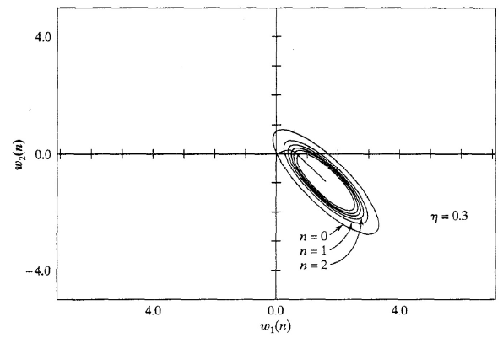
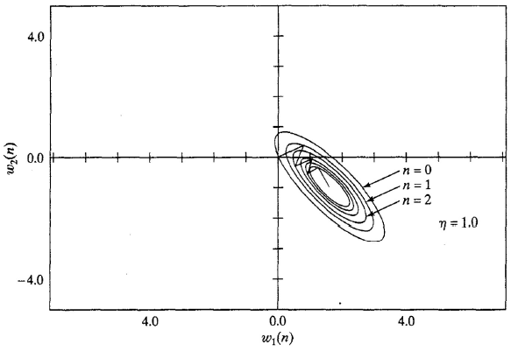



Influence of $ƞ$ on convergence
$Ƞ$ is small i.e. $ƞ$=0.3
$Ƞ$ is large i.e. $ƞ$=1.0

Slide 9
Gradient Descent

Slide 10
Gradient Descent

Slide 11
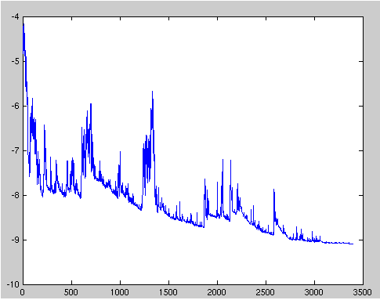
Stochastic Gradient Descent
Update parameters for each training example.

Slide 12
Mini Batch Gradient Descent
Update parameters for each mini batch range from 50 to 256.
Reduces the variance in the parameter updates.

Slide 13
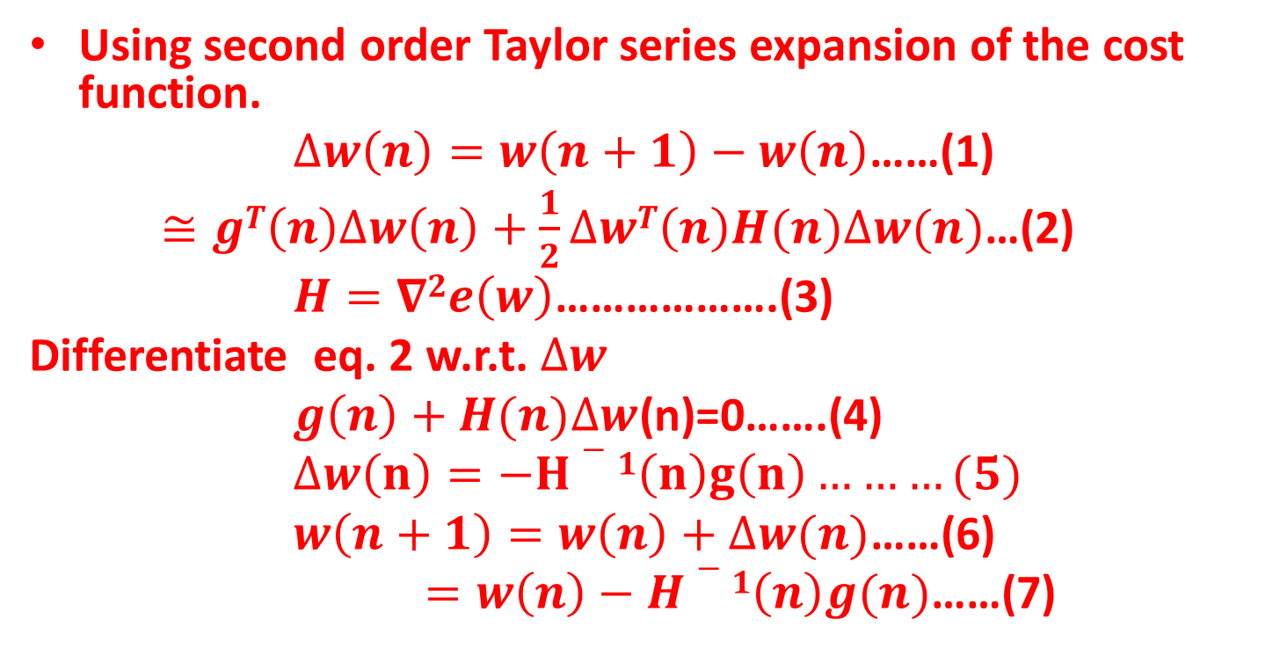
Newton’s Method
Using second order Taylor series expansion of the cost function.
$∆w\left(n\right)=w\left(n+1\right)−w\left(n\right)$……(1)
$≅gT\left(n\right)∆w\left(n\right)+\frac{1}{2}∆wT\left(n\right)H(n)∆w(n)$…(2)
$H=∇2e\left(w\right)$……………….(3)
Differentiate eq. 2 w.r.t. $∆w$
$g\left(n\right)+H(n)∆w$(n)=0…….(4)
$∆w\left(n\right)=−H−1\left(n\right)g\left(n\right)………(5)$
$w\left(n+1\right)=w\left(n\right)+∆w(n)$……(6)
$=w\left(n\right)−H−1\left(n\right)g(n)$……(7)

Slide 14
Thank You !!!

